Slide 1
Indian Sign Language with Emotion Recognition

Slide 2


Contents
Introduction
Need of the Product
Survey
Problem Formulation
Proposed Design
Implementation
Conclusion
References
Appendix

Slide 3

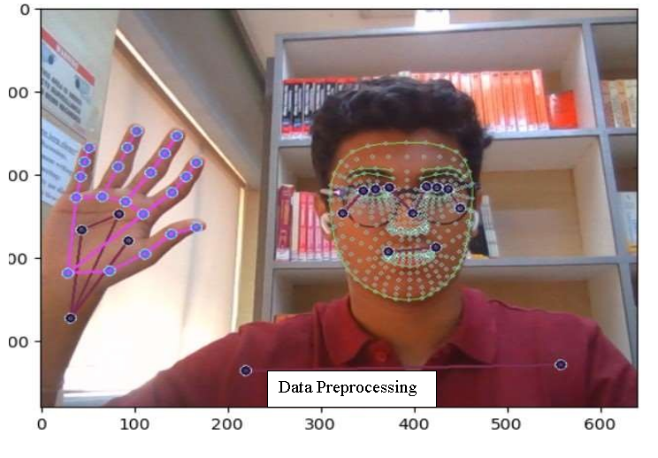
Introduction
In this presentation, we will delve into the innovative project titled 'Indian Sign Language with Emotion Recognition.' This groundbreaking research introduces a real-time sign language recognition system coupled with emotion analysis, using advanced machine learning techniques. Aimed at bridging the communication barriers faced by the hearing-impaired community, this project represents a signiﬁcant milestone in the ﬁeld of assistive communication technologies.

Slide 4

Need of the Product
Addressing Challenges of Hearing-Impaired Individuals
1
Why is the product needed?
The need for an effective sign language recognition system arises from the challenges faced by hearing-impaired individuals in their social interactions. The proposed system addresses the time-consuming nature of learning sign language and the need for interpretation services in various domains, including medical, educational, legal, and training sessions.
Drawbacks of Existing System
Current technologies often focus on either sign language recognition or emotion detection independently. The proposed system integrates both, providing a comprehensive solution and improving the accessibility of the hearing-impaired community.
Applications of the Product
The system ﬁnds applications in medical, educational, legal, and training settings, offering real-time sign language translation and emotion analysis. It contributes to a more inclusive and eﬃcient communication process.

Slide 5

Survey
Insights from Field and Literature Survey
Field Survey
Literature Survey
Outcome of the survey
The ﬁeld survey involves careful planning, ethical considerations, and a systematic approach to gathering data directly from hearing-impaired community within their natural environments. The insights gained from such surveys can be invaluable for understanding their perspectives, challenges, and preferences.
The literature survey presents an in-depth exploration of existing research papers and insights from experts in the ﬁeld. This form of survey helps in understanding the current trends, methodologies, and challenges related to Indian Sign Language and emotion recognition.
The outcomes and conclusions drawn from the survey on Indian Sign Language (ISL) with emotions are multifaceted based on the collected data. The survey data provides insights into awareness, challenges, interest, beneﬁts, potential applications, community integration, and interest in further research.

Slide 6
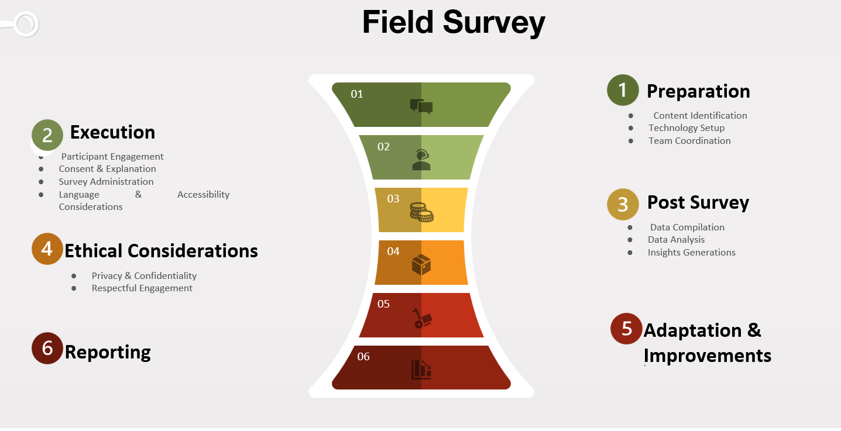



Slide 7

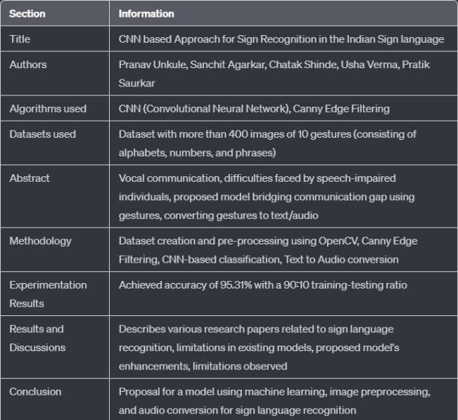
Literature Survey
The image beside shows an example of one of the research paper whose contents were studied in depth, understood and summarized. Such summaries were conducted for 5 research papers in total.

Slide 8
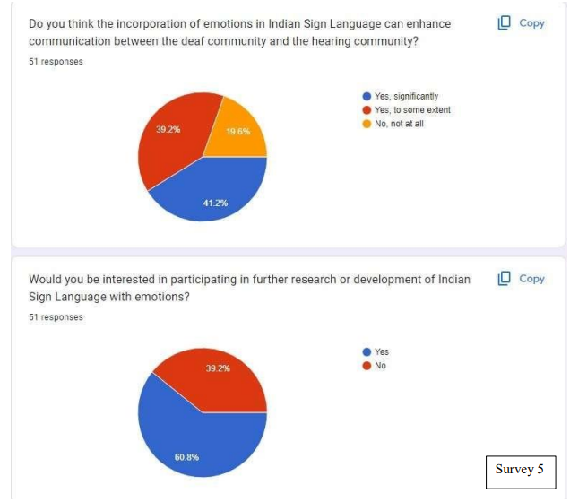
Outcome of the survey
Conclusions:
1.Awareness And Proficiency
2.Challenges In Emotional Expression
3. Interest In Learning
4. Perceived Benefits
5. Potential Applications
6. Community Integration
7. Interest in Further Research
Recommendations:
Educational Initiatives:
Tool Development
Community Engagement

Slide 9
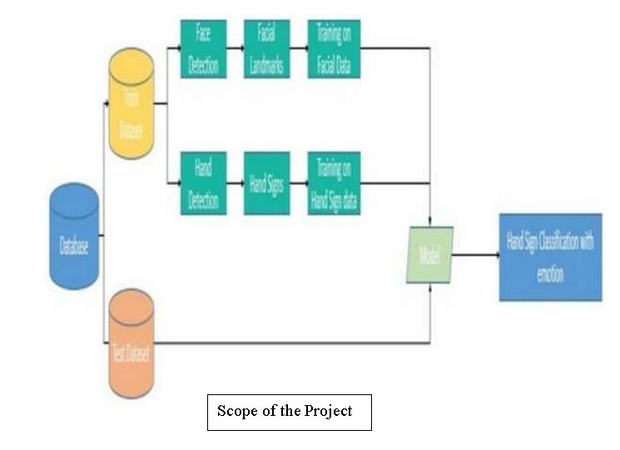
Problem Formulation
The project aims to develop a real-time sign language recognition system with emotion analysis, addressing the challenges faced by hearing-impaired individuals in expressing both signs and emotions simultaneously.
The system will recognize ISL signs and emotions in real-time, providing a simultaneous conversion to text and emotion display.

Slide 10
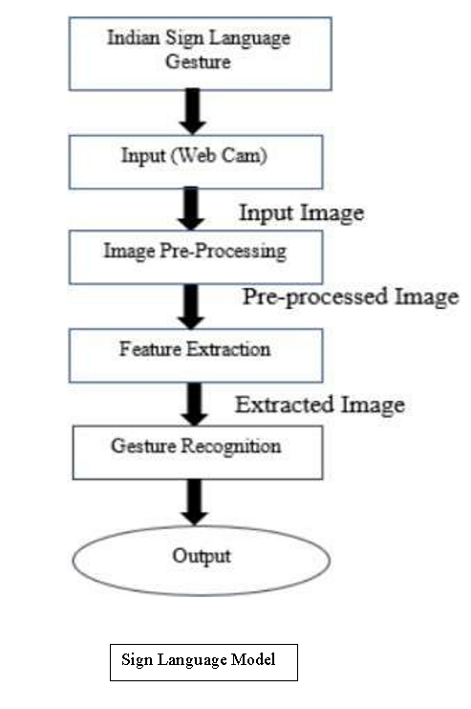
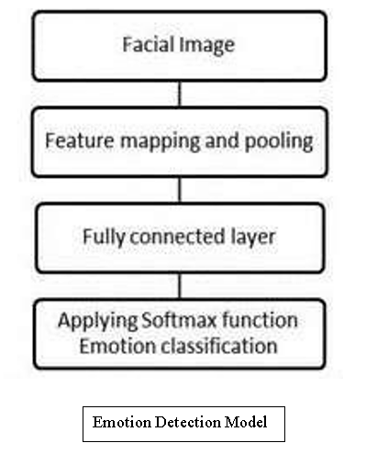
Proposed Design
Implementation Plan and Use Cases
1
Proposed Model
The proposed model consists of two parts: Sign Language Detection and Emotion Detection. It also includes a
self-generated Indian Sign Language dataset and pre-existing
facial emotion datasets for training and testing.
2 Use Cases
The system's versatility allows applications in medical consultations, educational settings, legal proceedings, and training sessions, contributing to the independence of hearing-impaired individuals.

Slide 11
Implementation
Technical Details and Real-Time Feasibility
GUI Design
Experimentation & Results
The GUI design involves setting up MediaPipe Holistic, data collection, training LSTM model, predictions, and real-time application. It also includes the CNN model implementation, datasets, test cases, parameter tuning, real-time feasibility, and integration with the overall system.
This section involves data preprocessing, model ﬁtting, predictions, model evaluation, and real-time working. It also includes details about the facial emotion datasets used and the accuracy results achieved.

Slide 12
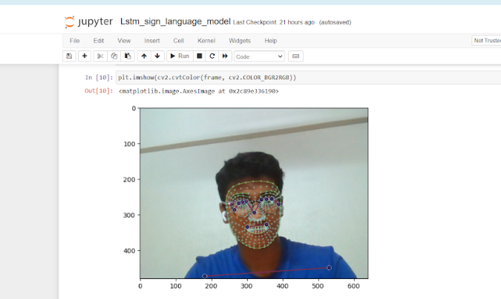
Experimentation and Results

Slide 13
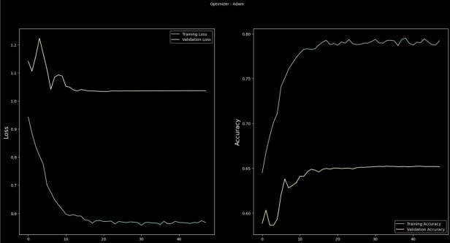
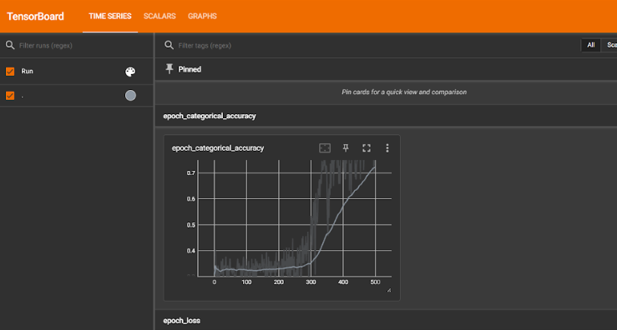
Model Evaluation

Slide 14
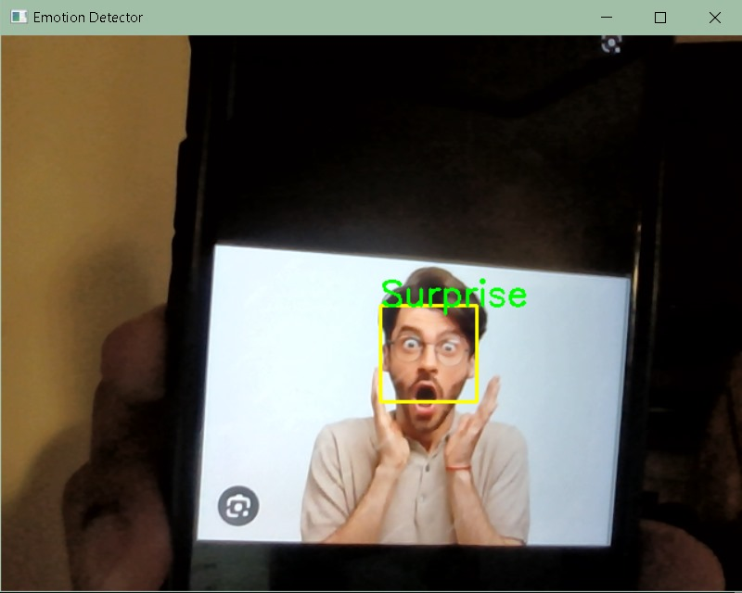
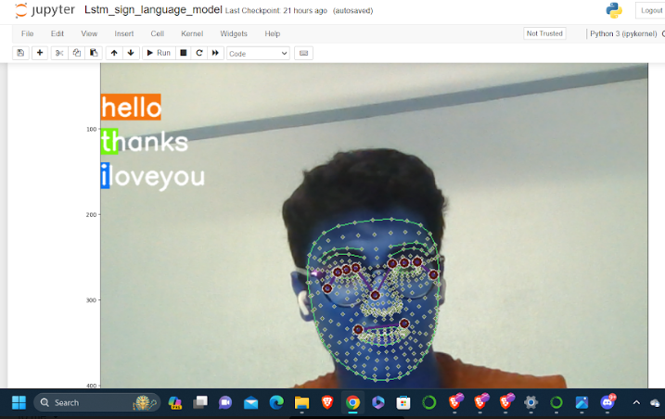
Real-time working

Slide 15
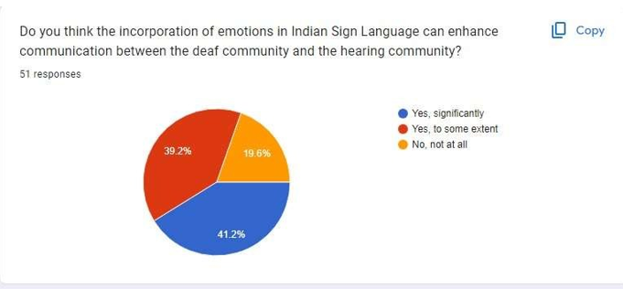
Conclusion
Revolutionizing Communication for the Hearing-Impaired
Summary
The comprehensive real-time sign language recognition system, coupled with emotion analysis, brings forth a revolutionary solution for inclusive communication. By integrating LSTM for sign language and CNN for emotion detection, the system caters to the varied needs of the hearing-impaired community, addressing the limitations of existing systems.
References / Bibliography
The presentation includes references to research papers and insights from experts in the ﬁeld, providing credibility and background context for the project.

Slide 16
References
Tiku, K. et al. (2020). Real-time Conversion of Sign Language to Text and Speech. Riyantoko, P.A. et al. (2021). Facial Emotion Detection Using Haar-Cascade Classiﬁer and Convolutional Neural Networks. Sahana,
T. et al. (2020). Hand sign recognition from depth images with multi-scale density features for deaf mute persons. Mellouk, W. et al. (2020). Facial emotion recognition using deep learning: review and insights.

